Slide 1
How to globally change lending loan due dates to a future date
Yoel Kortick
Senior Librarian

Slide 2
Introduction
Sample items on loan
Bulk change the due dates
Checking the results of the job

Slide 3
Introduction

Slide 4
Introduction
There may be an unexpected situation in which the due dates of items already loaned need to be changed to a later date than the original due date.
This may include all items on loan, or a subset, such as particular libraries, particular locations, particular material types and particular user groups .
This presentation will show how this may be done.

Slide 5
Sample items on loan

Slide 6
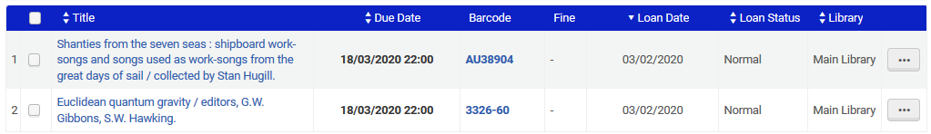
Sample items on loan
Barcode AU38904 and 3326-60 are both on loan and due on March 18th 2020 and belong to the Main Library.

Slide 7
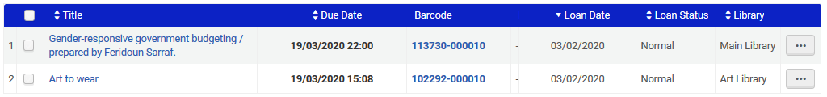
Sample items on loan
Barcode 113730-000010 and 102292-000010 are both on loan and due on March 19th 2020. 113730-000010 belongs to the Main Library and 102292-000010 belongs to the Art Library.

Slide 8
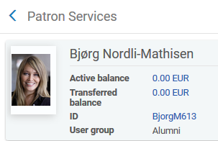
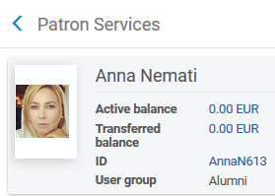
Sample items on loan
All four items are loaned to patrons with user group “Alumni”

Slide 9
Bulk change the due dates

Slide 10
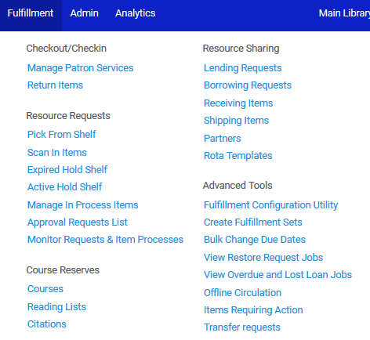
Bulk change the due dates
Under “Fulfillment > Advanced Tools” choose “Bulk Change Due Dates”

Slide 11
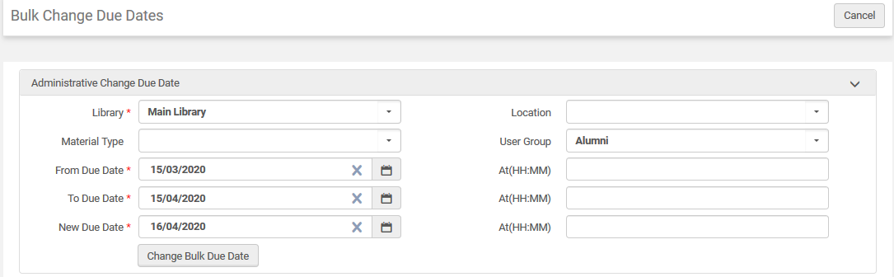
Bulk change the due dates
Here we state that any item in the Main Library loaned to user group “Alumni” and due between Match 15 and April 15 will change to due date April 16. We will click “Change Bulk Due Date”. When a field is left blank it means “all values”.

Slide 12
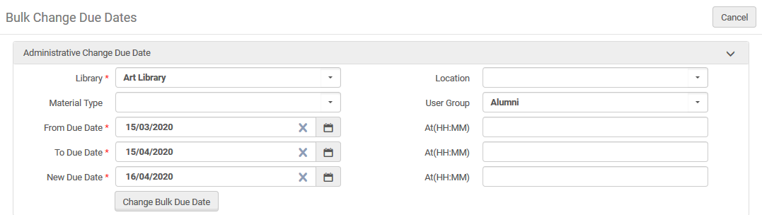
Bulk change the due dates
Here we state that any item in the Art Library loaned to user group “Alumni” and due between March 15, 2020 and April 15, 2020 will change to due date April 16, 2020. We will click “Change Bulk Due Date”

Slide 13
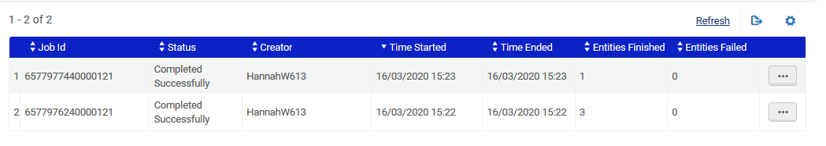
Bulk change the due dates
Both jobs have successfully completed

Slide 14
Checking the results of the job

Slide 15
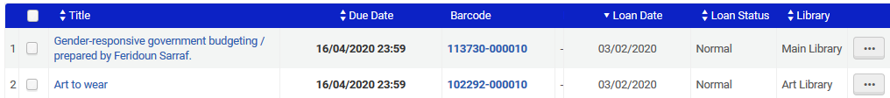
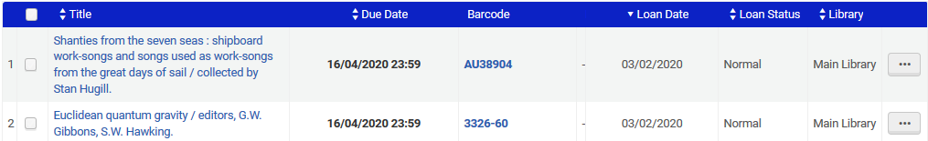
Checking the results of the job
We see that the due date for these four items was changed to April 16th, 2020, as specificed in the job.

Slide 16
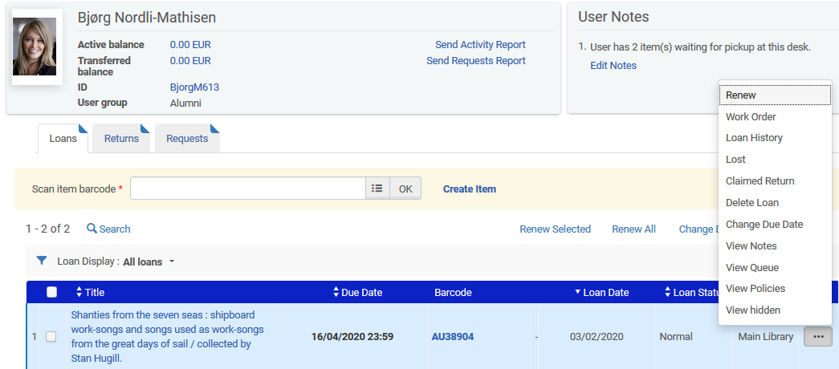
Checking the results of the job
And if we look at the loan history …

Slide 17
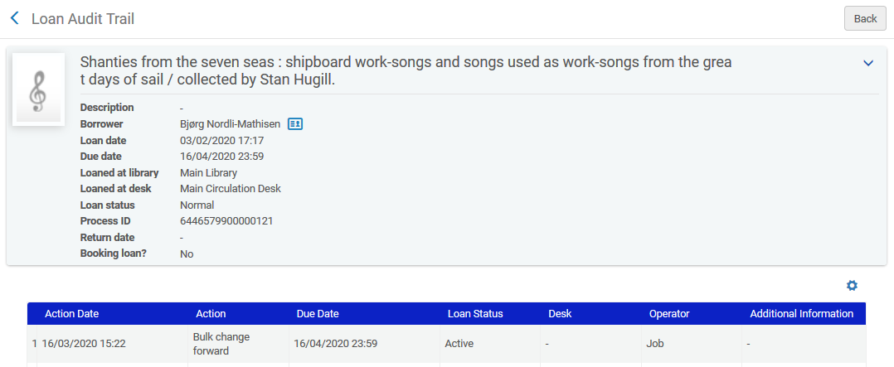
Checking the results of the job
We see that the due date changed because of the job

